Slide 1
Module 5.4.2: Dictionaries

Slide 2
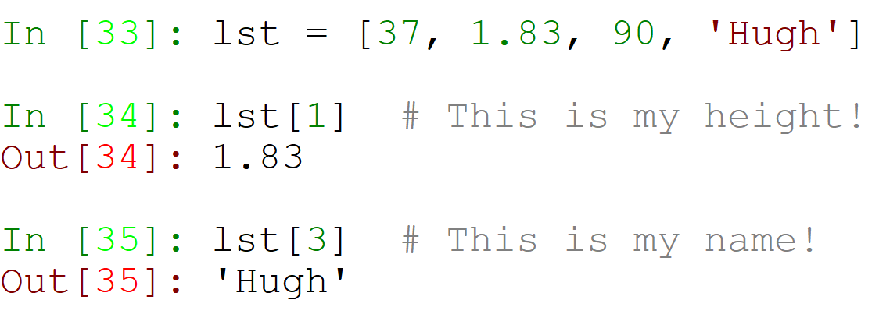
Lists store values by index.

Slide 3
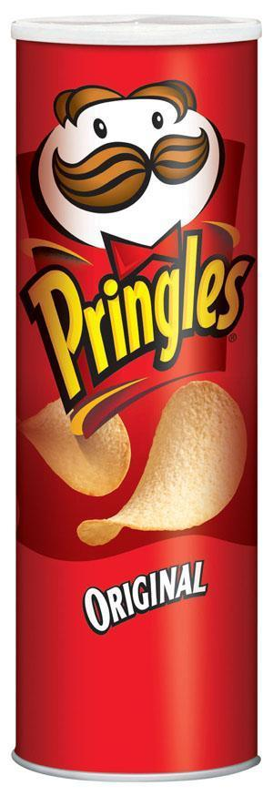

Pringles vs. Suitcase
Lists are like a jar of Pringles –
Dictionaries are like a suitcase! It is filled with values that have names.

Slide 4
Our Suitcase – Values Have Names!
sunglasses
tissue
calculator
perfume
money
candy

Slide 5
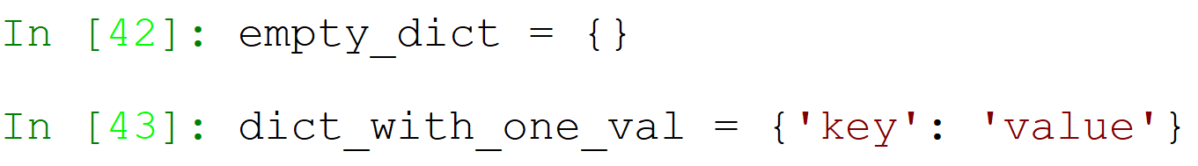
Creating a Dictionary
Dictionaries are created with curly brackets!
Every new item in the dictionary has a:
key – the name of the value
value – the value itself
The key and value are separated by a colon.

Slide 6
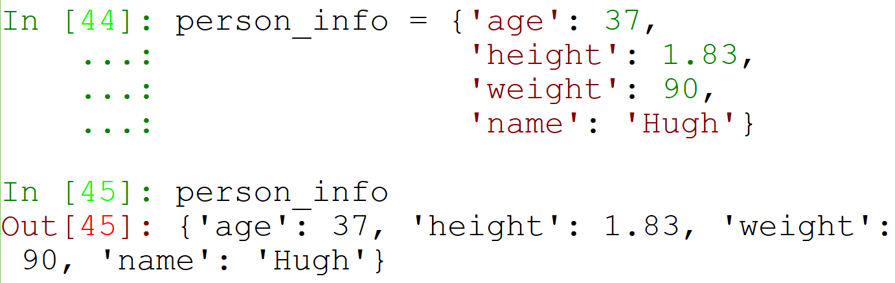
Now let’s save our info again!
As you can see, order has no importance in a dictionary, because the index is not counted, but named!

Slide 7
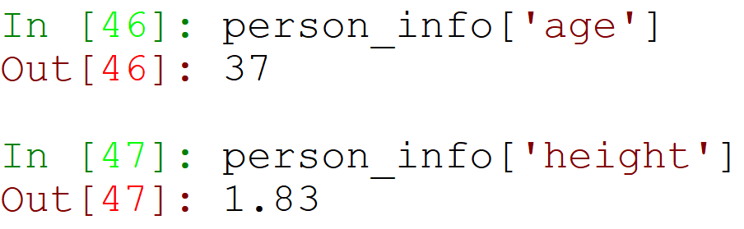
Getting a Value from a Dictionary
The value of a key can be fetched by using square brackets (like in lists!), but this time with the key name, not the index ID.

Slide 8
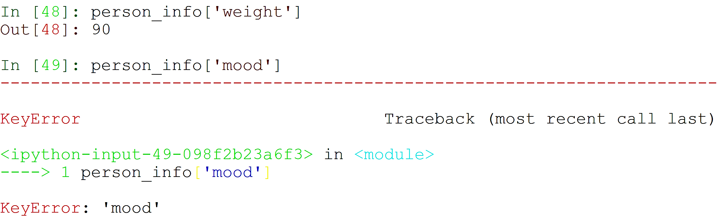
What if there is no such key?
A KeyError is raised! It means that no such key was found in the dictionary.

Slide 9
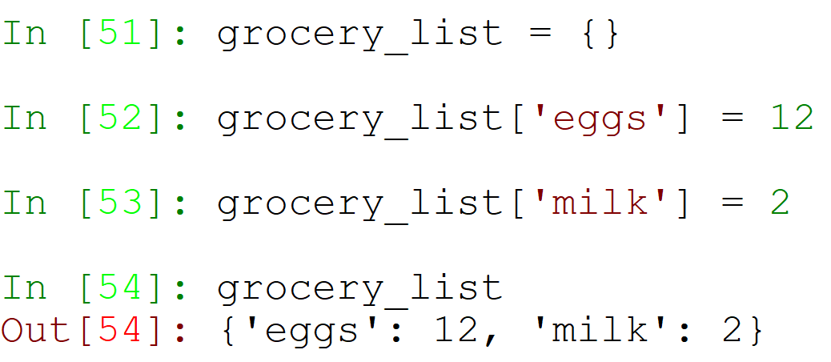
Adding Key/Values to a Dictionary
A new key/value pair can be added to the dictionary easily.
Use the key as an index, but this time assign it a value – just like creating variables!

Slide 10
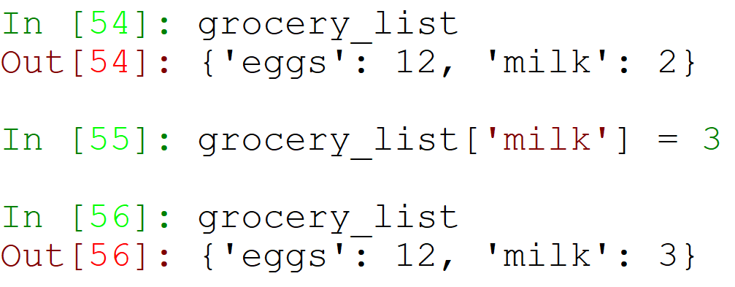
Adding Existing Keys
Just like in variables, assigning a new value erases the last value, and switches it with the new value.

Slide 11
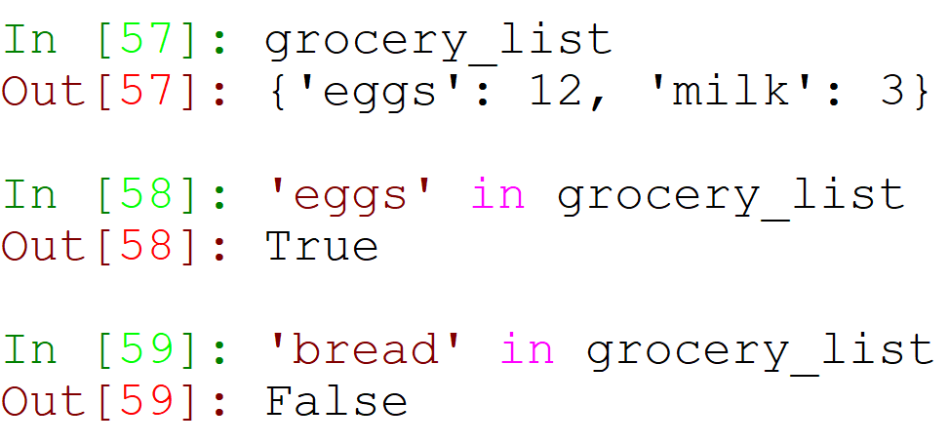
Checking if a Key is in a Dictionary
Just like with lists, we can use the in keyword:

Slide 12
Dictionary Methods

Slide 13
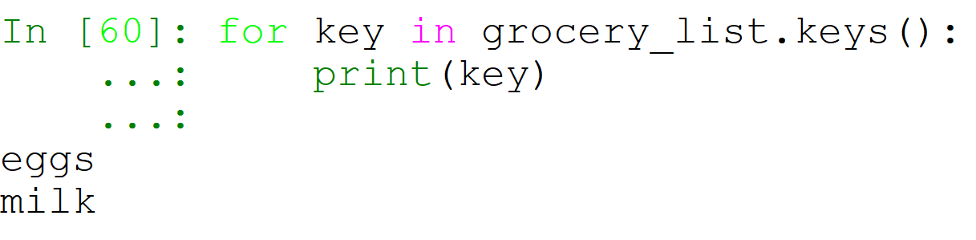
dict.keys()
The keys method returns a sequence of all keys in the dictionary:

Slide 14
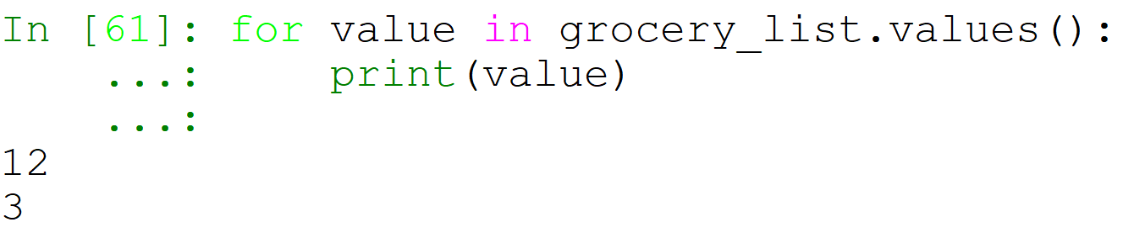
dict.values()
The values method returns a sequence of all values in the dictionary:

Slide 15
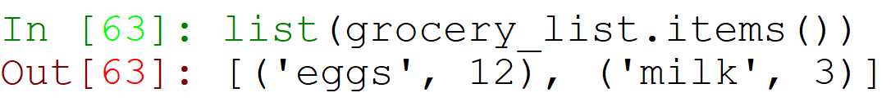
dict.items()
The items method returns a sequence of tuples.
Each tuple is built up of (key, value).

Slide 16
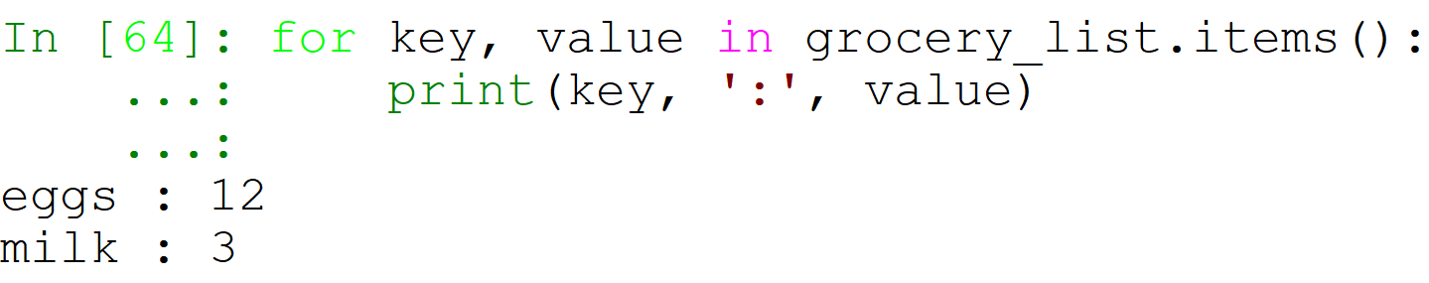
Unpacking dict.items()
When each list item is a tuple of length 2, we can use unpacking in our for loop!
This means that each iteration in our loop assigns 2 values – one to key and one to value.

Slide 17
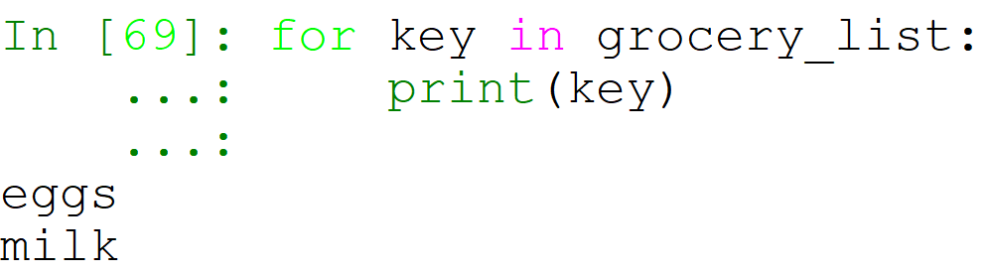
Using a for loop with no method
What happens if we just use a for loop on a dictionary itself?
Well, what happened when we used the in keyword?
It looked in the dictionary’s keys!
So it should do the same…

Slide 18
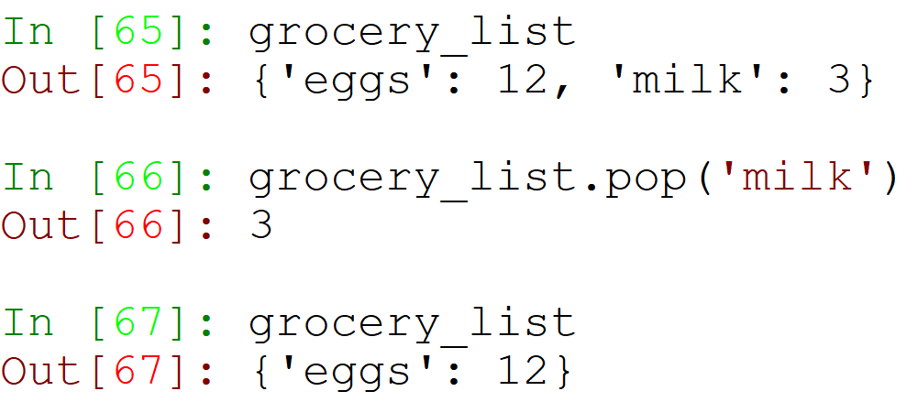
dict.pop()
The pop method:
Receives a key
Removes that key from the dictionary
Returns the key’s value

Slide 19
Are there other dictionary methods?
Of course!
Use dir(dict) to find them.
Read about them with help(dict.method), ?, or in the Python Documentation!

Slide 20
What types can we use as dictionary keys?
Let’s try!

Slide 21
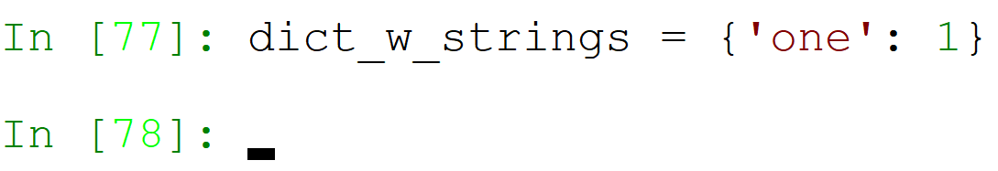

Strings?

Slide 22
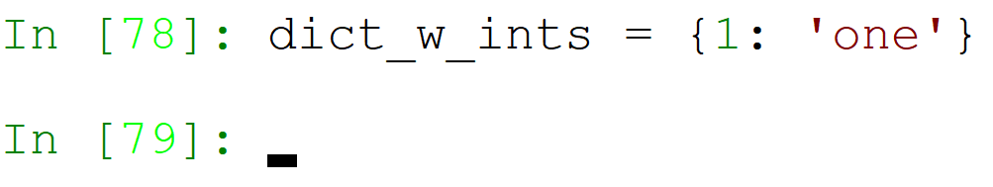
Integers?

Slide 23
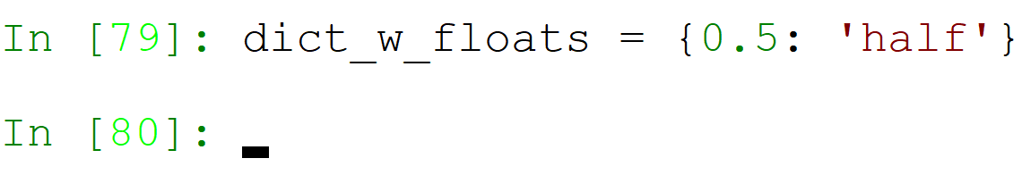
Floating Points?

Slide 24
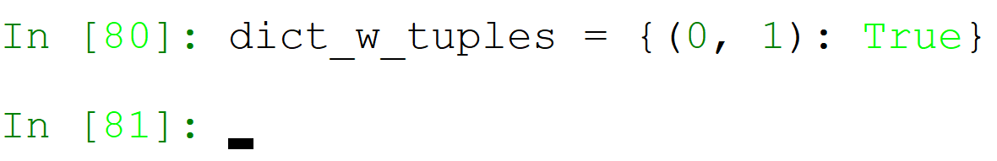
Tuples?

Slide 25
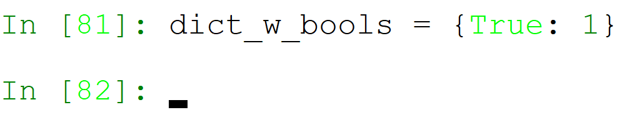
Booleans?

Slide 26
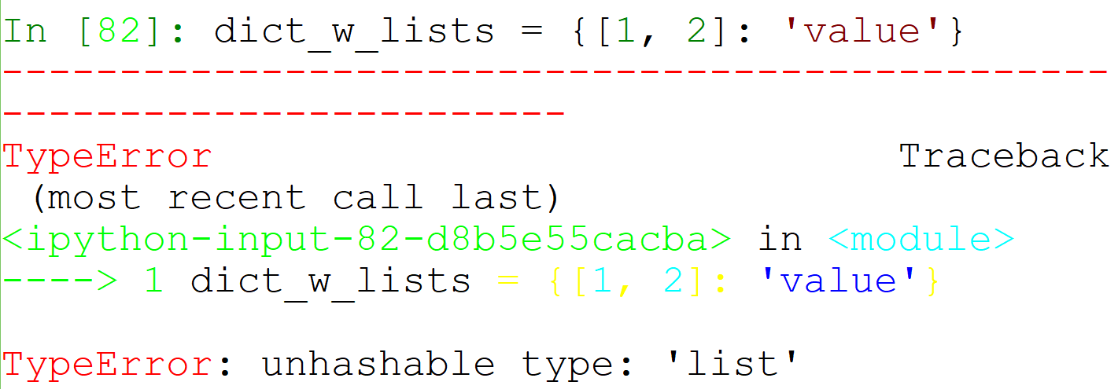

Lists?

Slide 27
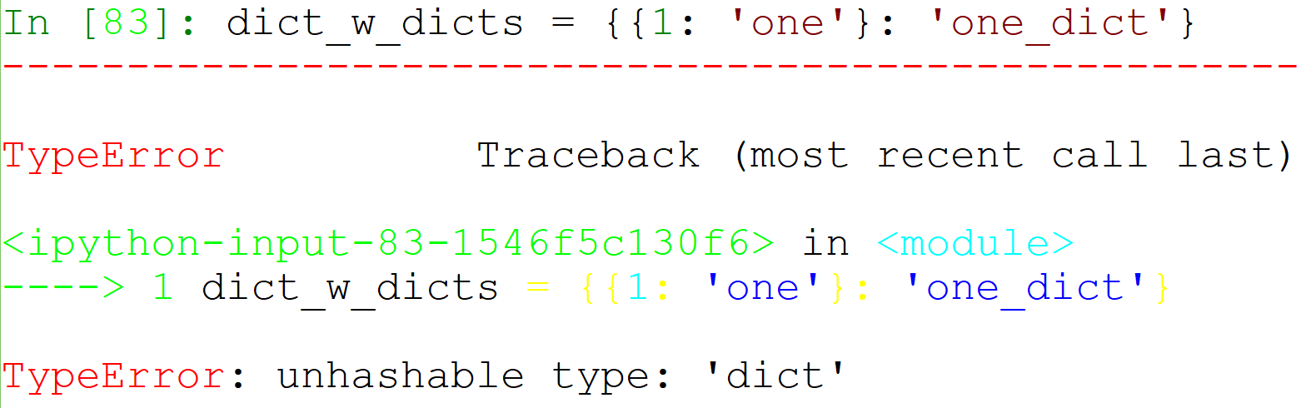
Another Dictionary?

Slide 28
So, what types can we use as dictionary keys?
What is the main difference between a list and a tuple?
A list is mutable – it can be changed!
Do we want our keys to be able to change in the middle of a run? No!
If they change, we will not be able to find our values!
So, dictionary keys can only be immutable.

Slide 29
Is a dictionary mutable or immutable?
A dictionary is mutable!
So, it can be changed, just like a list.
So, be careful when you send dictionaries to functions that can change them!
Remember to use the dict.copy() method if it is needed.

Slide 30
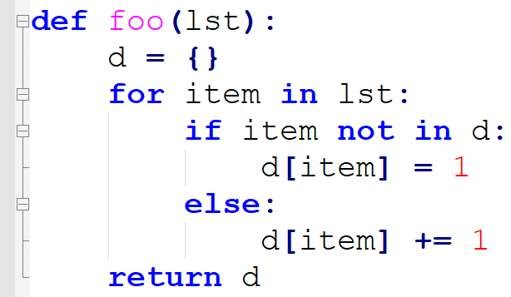
What does this function do?
A Counter!
It counts the number of times each item appears in the list.

Slide 31
Sets
Advanced Data Structures

Slide 32
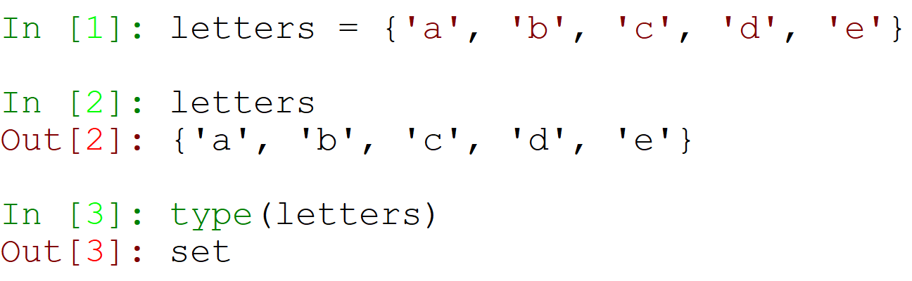
Creating a Set
Sets are a new sequence type, created by using curly brackets:

Slide 33
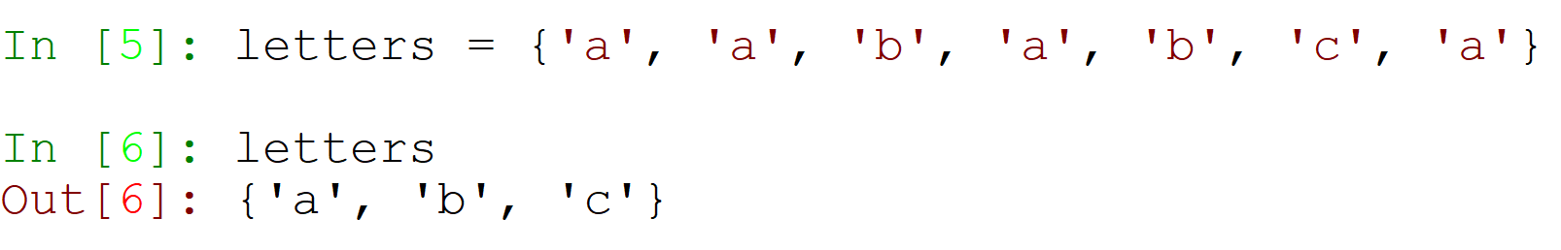
Set Qualities
Sets have two main qualities:
Sets don’t have any specific order.
They don’t even support indexing!
Sets hold only distinct values.
This means that there are no duplicate values!

Slide 34
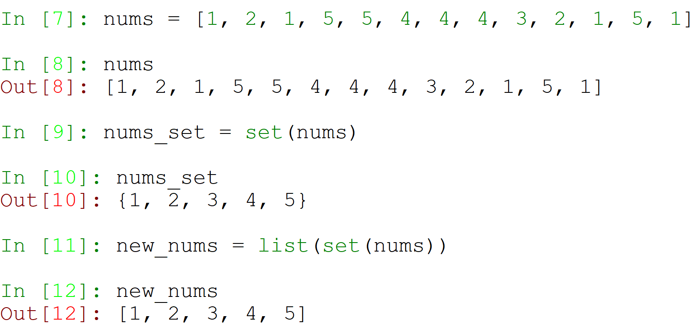
Creating a Distinct List
Problem:
The result can be any order!

Slide 35

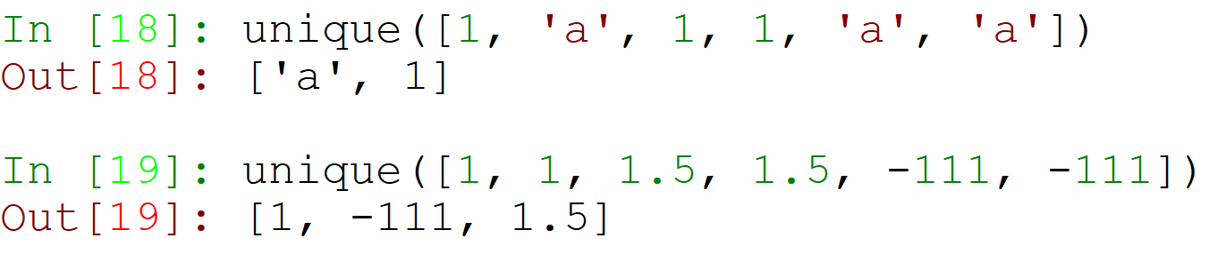
Let’s Create a unique Function!

Slide 36
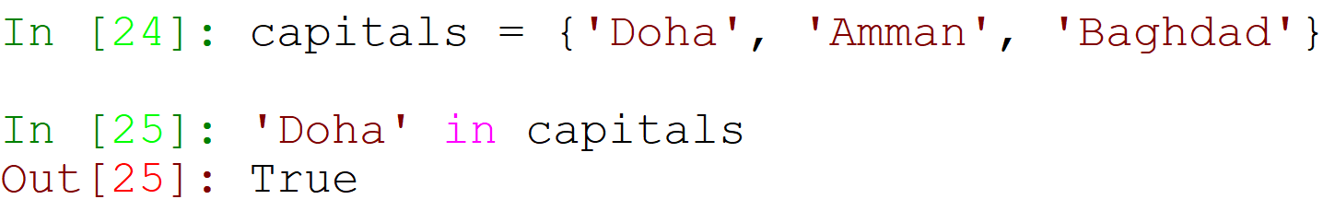
Using the in Keyword
Just like in lists, tuples, and dicts – using the in keyword can check if an item is in the set.

Slide 37
Set Methods and Operators
Method Name | Explanation | Example
add | Adds a new value to the set | {1, 2, 3}.add(4)
remove | Removes a value from the set | {1, 2, 3}.remove(2)
intersection | Returns a set with the items in the set that appear in the second set. | {1, 3, 5}.intersection({3, 4, 5}) >>> {3, 5}
set1 – set2 | Returns a set with the items in set1 that don’t appear in set2. | {1, 3, 5} – {3, 4, 5} >>> {1}
issubset | Returns True/False, depending on if all items in the set appear in the second set. | {0, 4, 7}.issubset(set(range(10))) >>> True

Slide 38
Mutable vs. Immutable Types
Mutable | Immutable
list | int
dict | float
set | str
 | tuple
 | bool

Slide 39
What did we learn?
Pointers
Mutable vs. Immutable Types
Downside of sending lists to functions
Dictionaries
Sets

